Slide 1
IT Budget Benchmark
Company XYZ Sample 123 8 December 2022

Slide 2
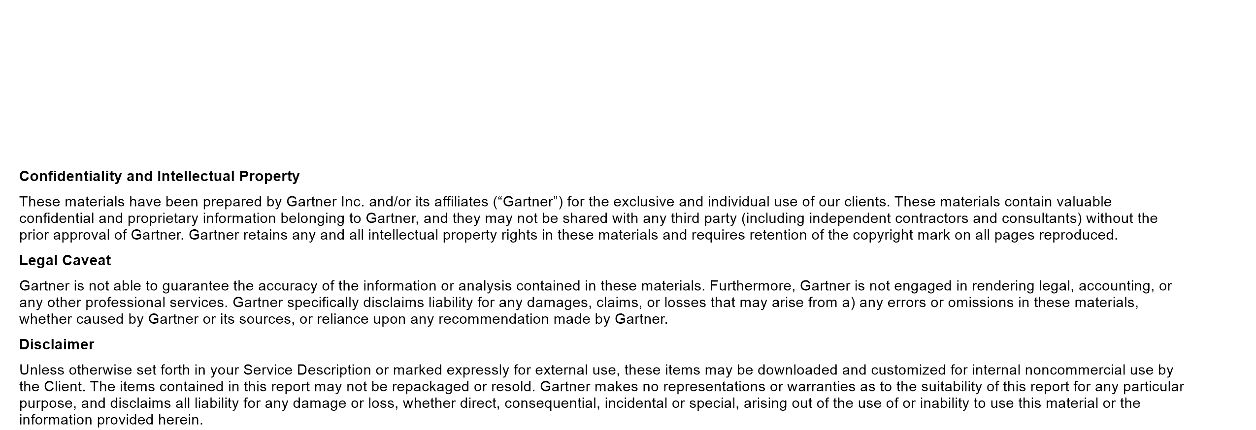
Disclaimer

Slide 3
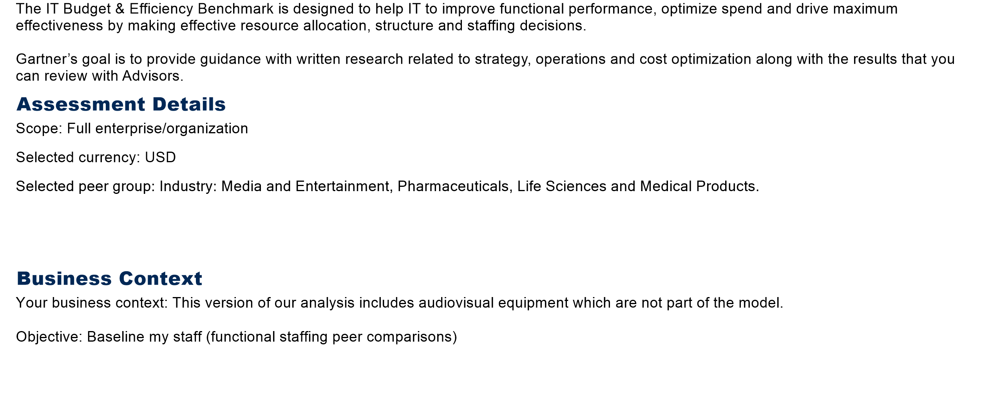
Introduction

Slide 4
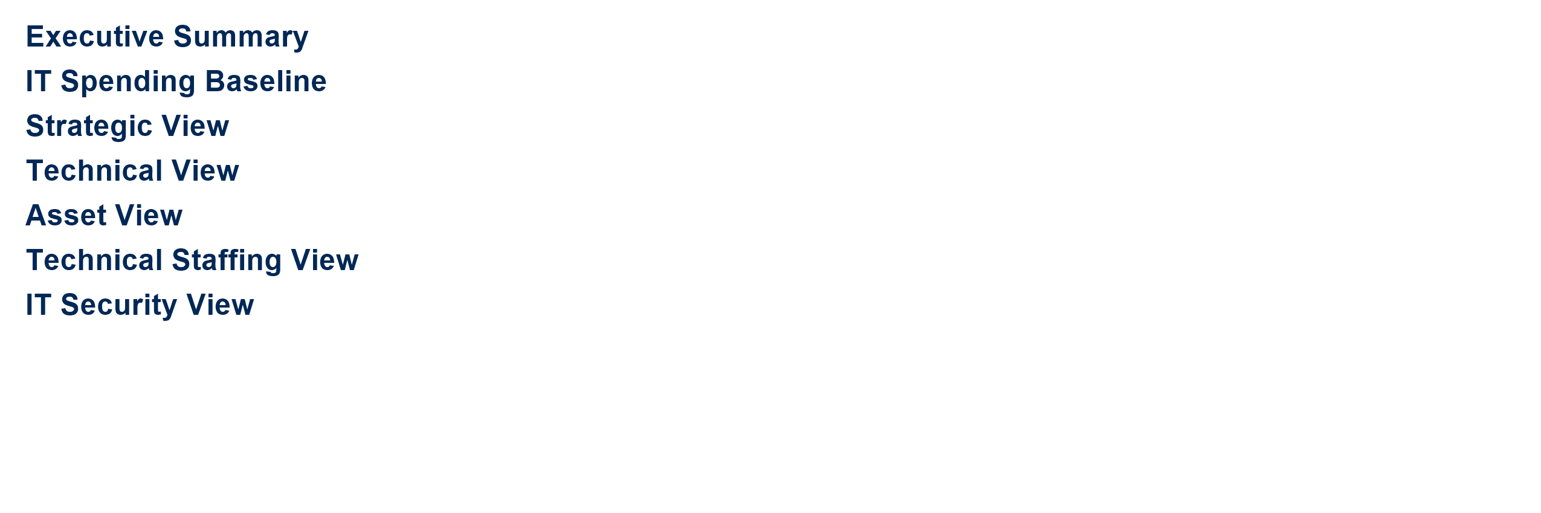
Table of Contents

Slide 5
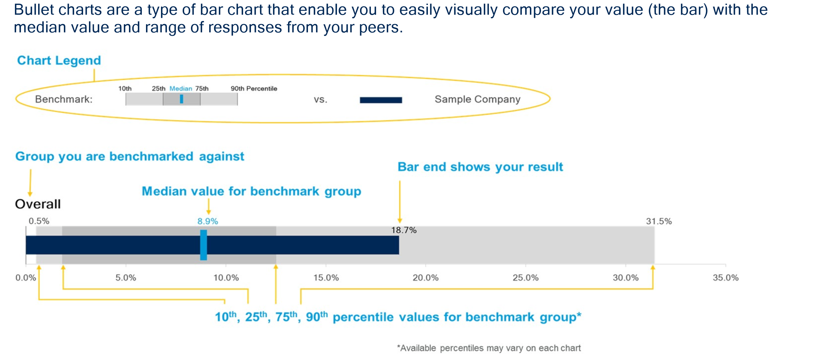
Bullet Chart Interpretation

Slide 6
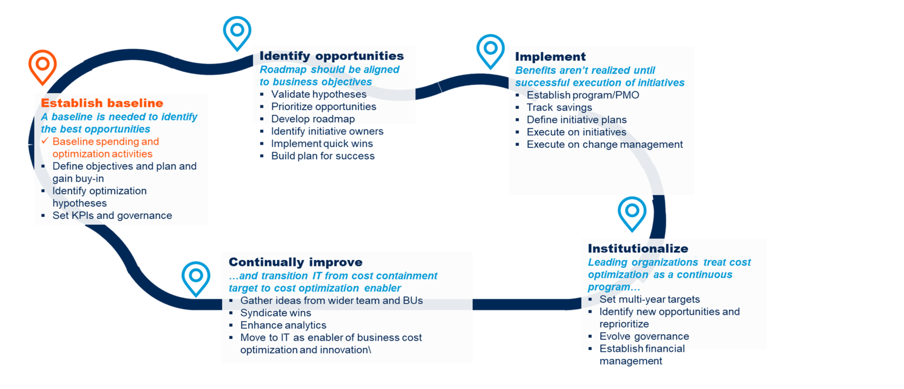
IT Budget supports the strategic cost optimization lifecycle to establish a baseline and measure continuous improvement​

Slide 7


Slide 8
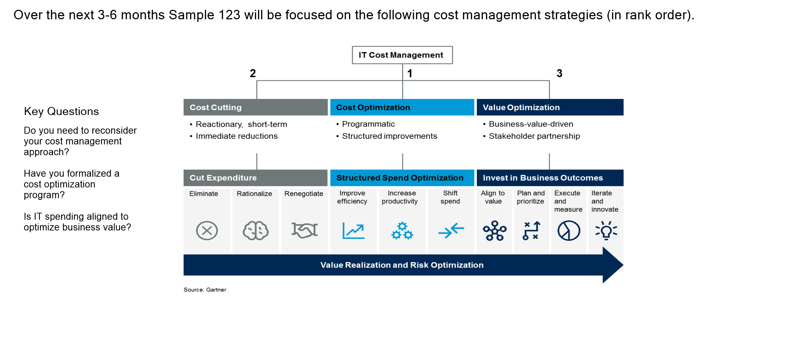
Top-performing CIOs deliver value by managing IT costs strategically and programmatically to drive business outcomes

Slide 9
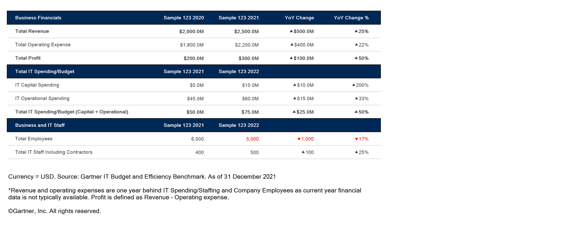
Sample 123 Profile

Slide 10
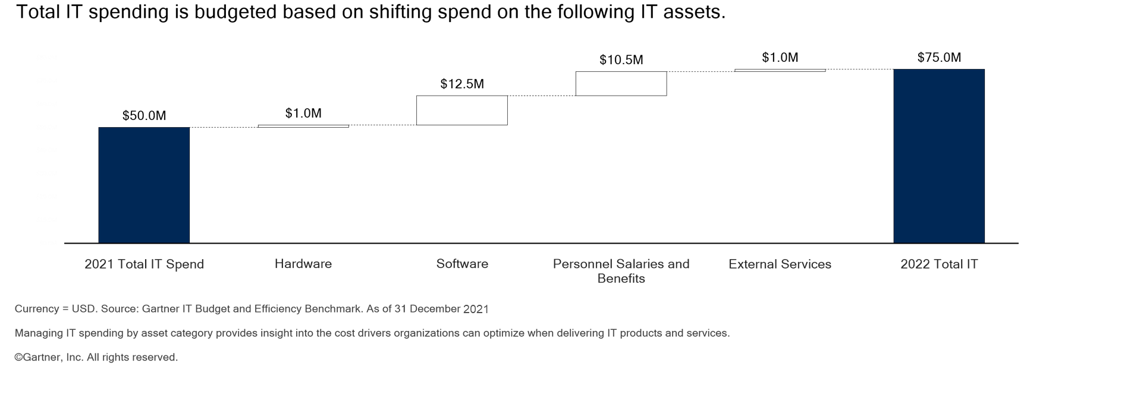
IT Spend Change by Asset Category

Slide 11
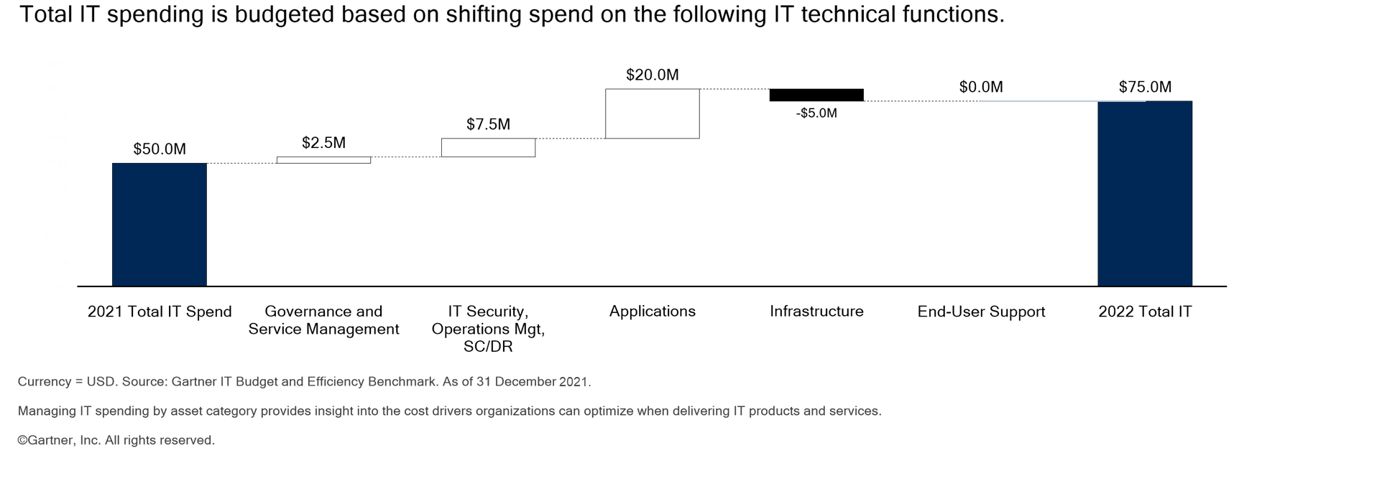
IT Spend Change by Technical Function

Slide 12
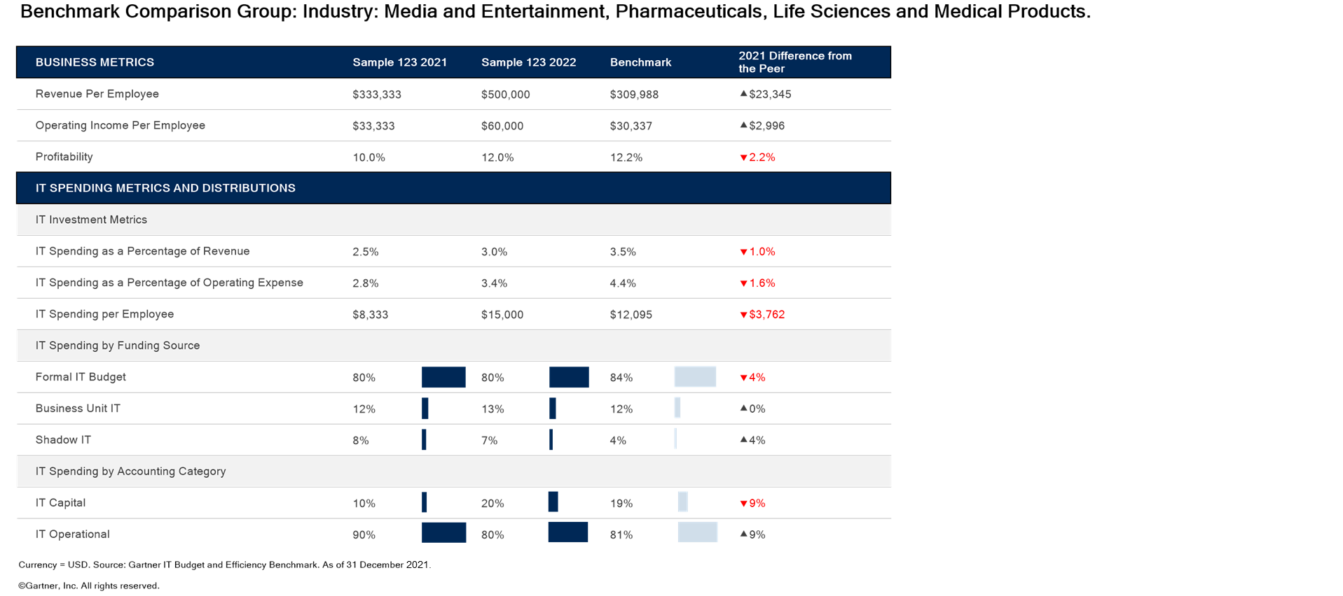
Executive Summary - IT Spend Baseline

Slide 13
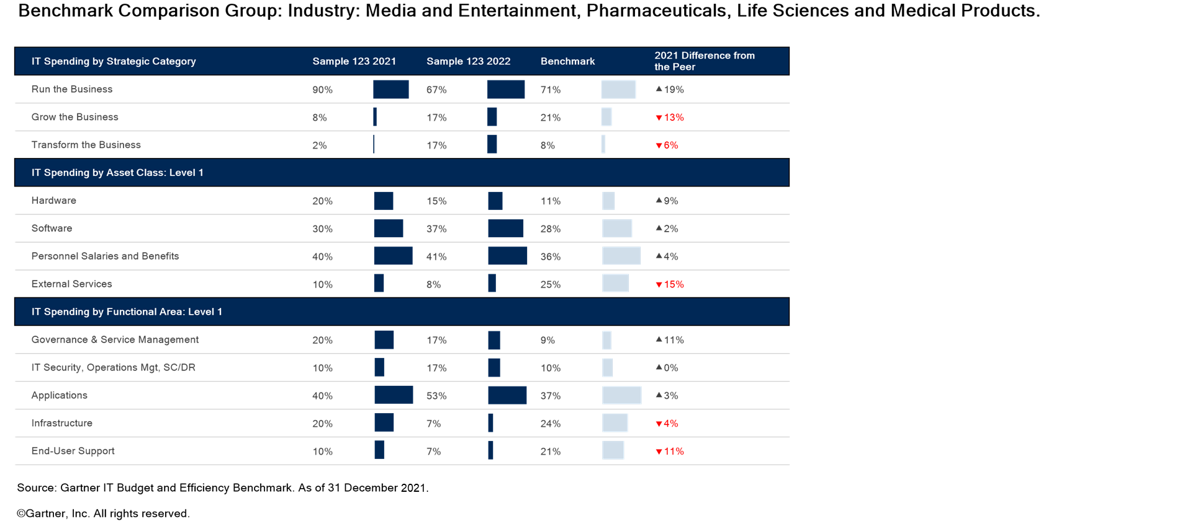
Executive Summary - IT Spend Distributions

Slide 14
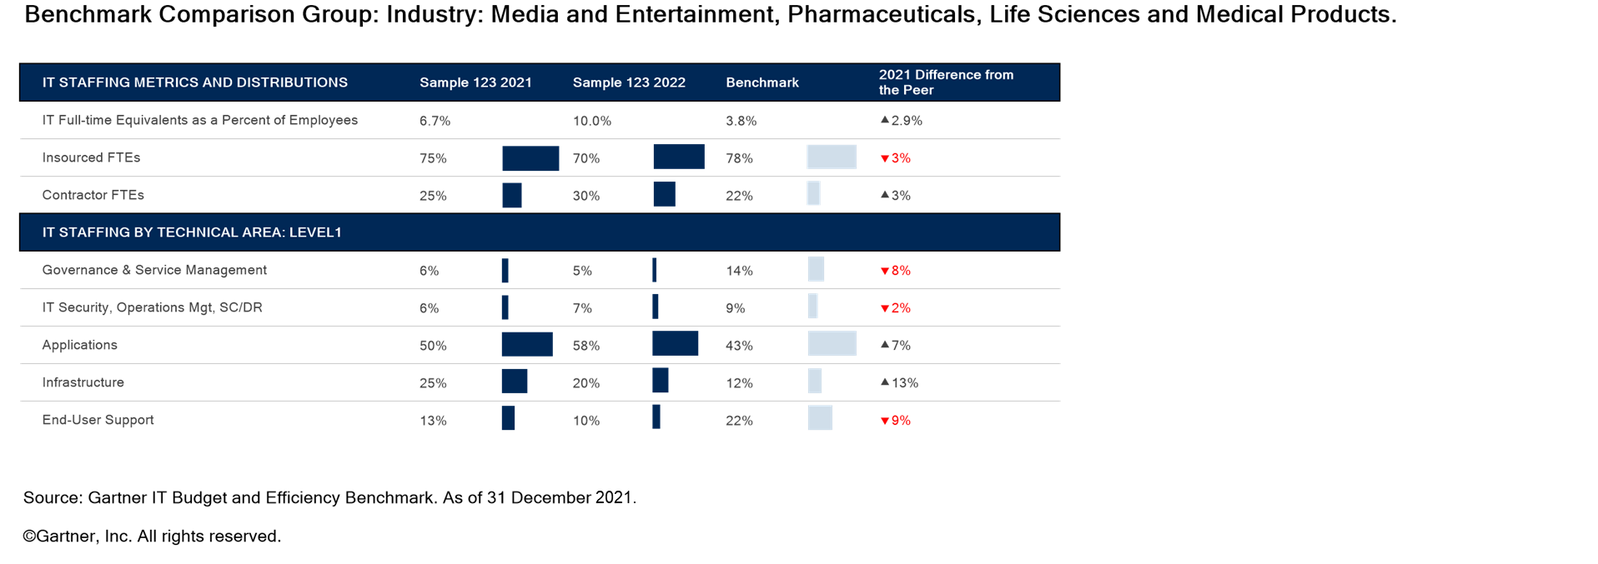
Executive Summary - IT Staffing

Slide 15
Recommended Resources
STRATEGIC COST OPTIMIZATION
Predicts 2022: 3 Must-Do’s for CIO Leadership Responsibilities The CIO’s Guide to Innovation Governance Kick-Start Your IT Value Story With Metrics That Matter 7 Rules for Demonstrating the Business Value of IT How to Use KPIs to Measure the Business Value of APIs 12 Rules of IT Cost Management - How to Respond to Mandatory IT Budget Cuts Expert Insight Video: 5 Best-Practice Rules for Chargeback Gartner Essential Frameworks for CIOs and Technology Executives

Slide 16
Recommended Resources
VENDORS AND CONTRACTS
Negotiating IT Contracts Gartner BuySmart IT Services and Solutions CIO Leadership, Culture and People Infrastructure and Operations Leaders Shared Services

Slide 17
Recommended Resources
IT STAFFING AND PROCESSES
CIO Leadership, Culture, and People CIO Leadership of Strategy, Governance, and Operating Models Infrastructure and Operations Leaders Application Leaders CIO Leadership, Culture and People Infrastructure and Operations Leaders Shared Services CIO Leadership, Culture and People Infrastructure and Operations Leaders Shared Services

Slide 18
Recommended Resources
APPLICATIONS, GOVERNANCE AND ITSM
PMO Evolution for Digital Program and Portfolio Management Leaders Application and Product Portfolio Governance Digital Workplace Infrastructure and Operations

Slide 19
Recommended Resources
INFRASTRUCTURE, END USER, IT SECURITY, OPERATIONS AND SC/DR
Data Center Infrastructure Cloud Computing Cloud and Edge Infrastructure Infrastructure, Operations and Cloud Management Sourcing, Procurement and Vendor Management Leaders

Slide 20


Slide 21
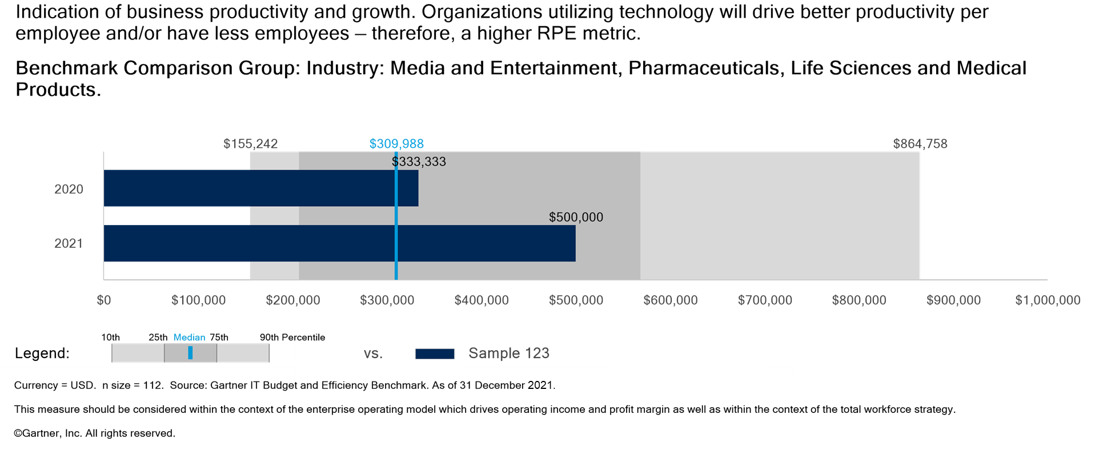
Revenue Per Employee (RPE)

Slide 22
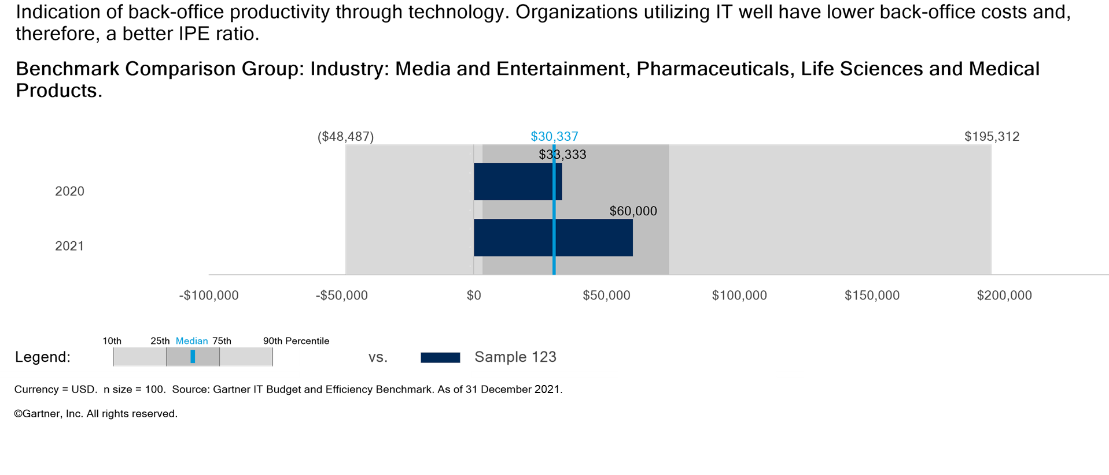
Operating Income Per Employee (IPE)

Slide 23
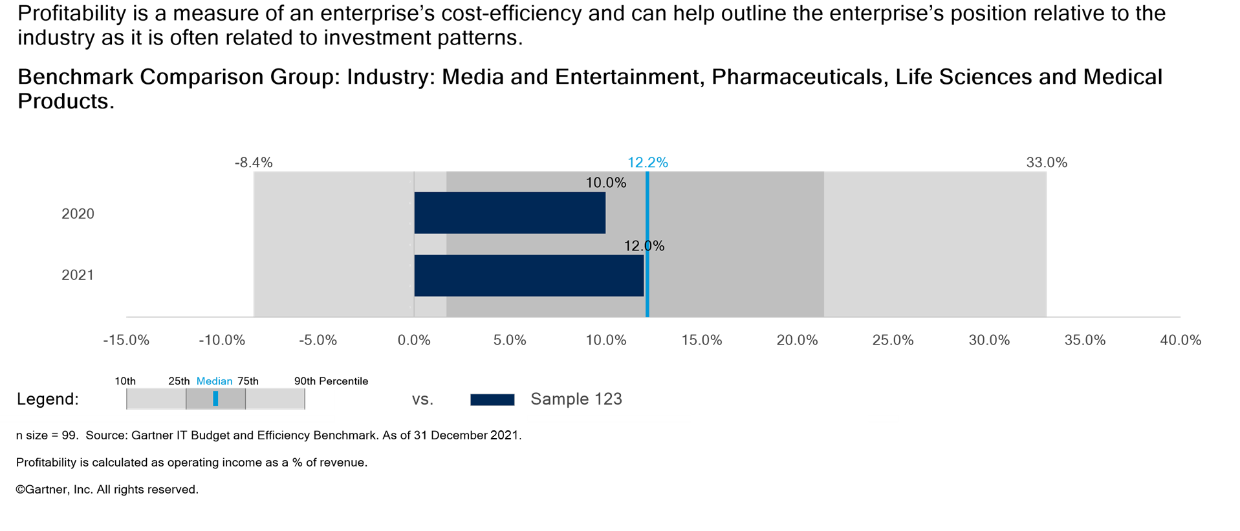
Profitability

Slide 24
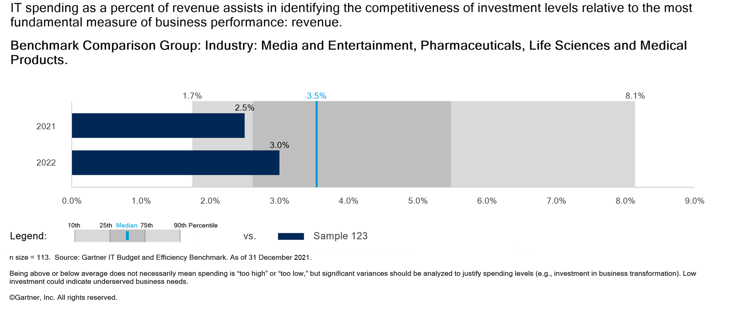
IT Spending as a % of Revenue

Slide 25
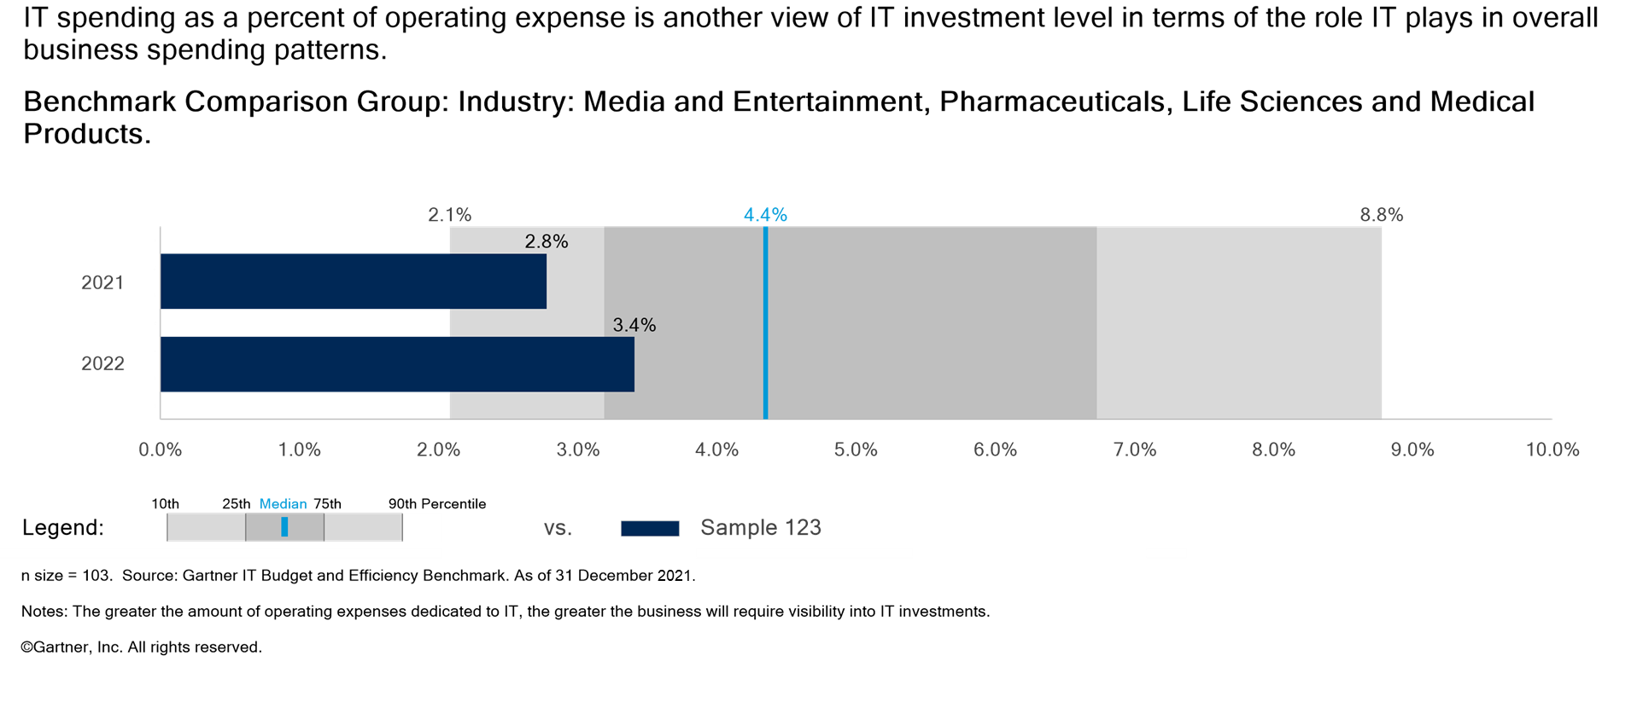
IT Spending as a % of Operating Expense

Slide 26
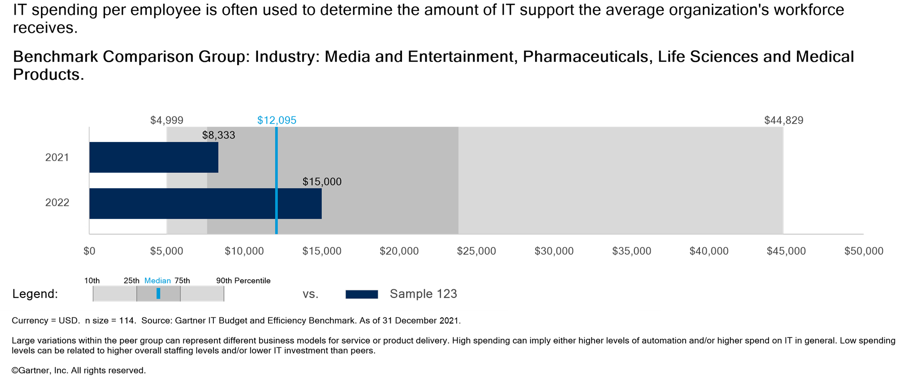
IT Spending Per Employee

Slide 27
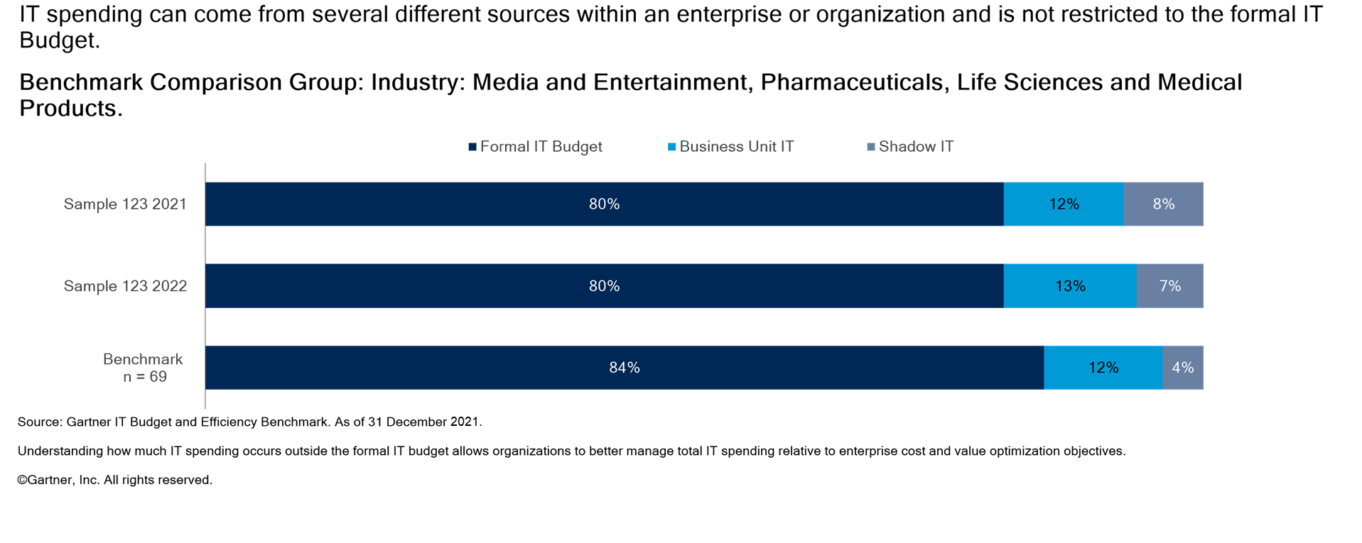
IT Spending by Funding Source

Slide 28
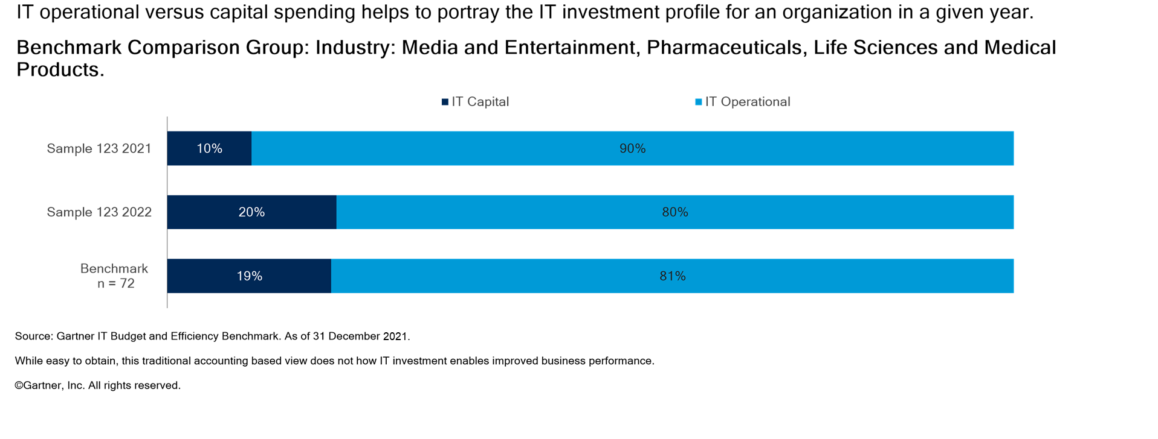
Capital vs. Operational IT Spending

Slide 29
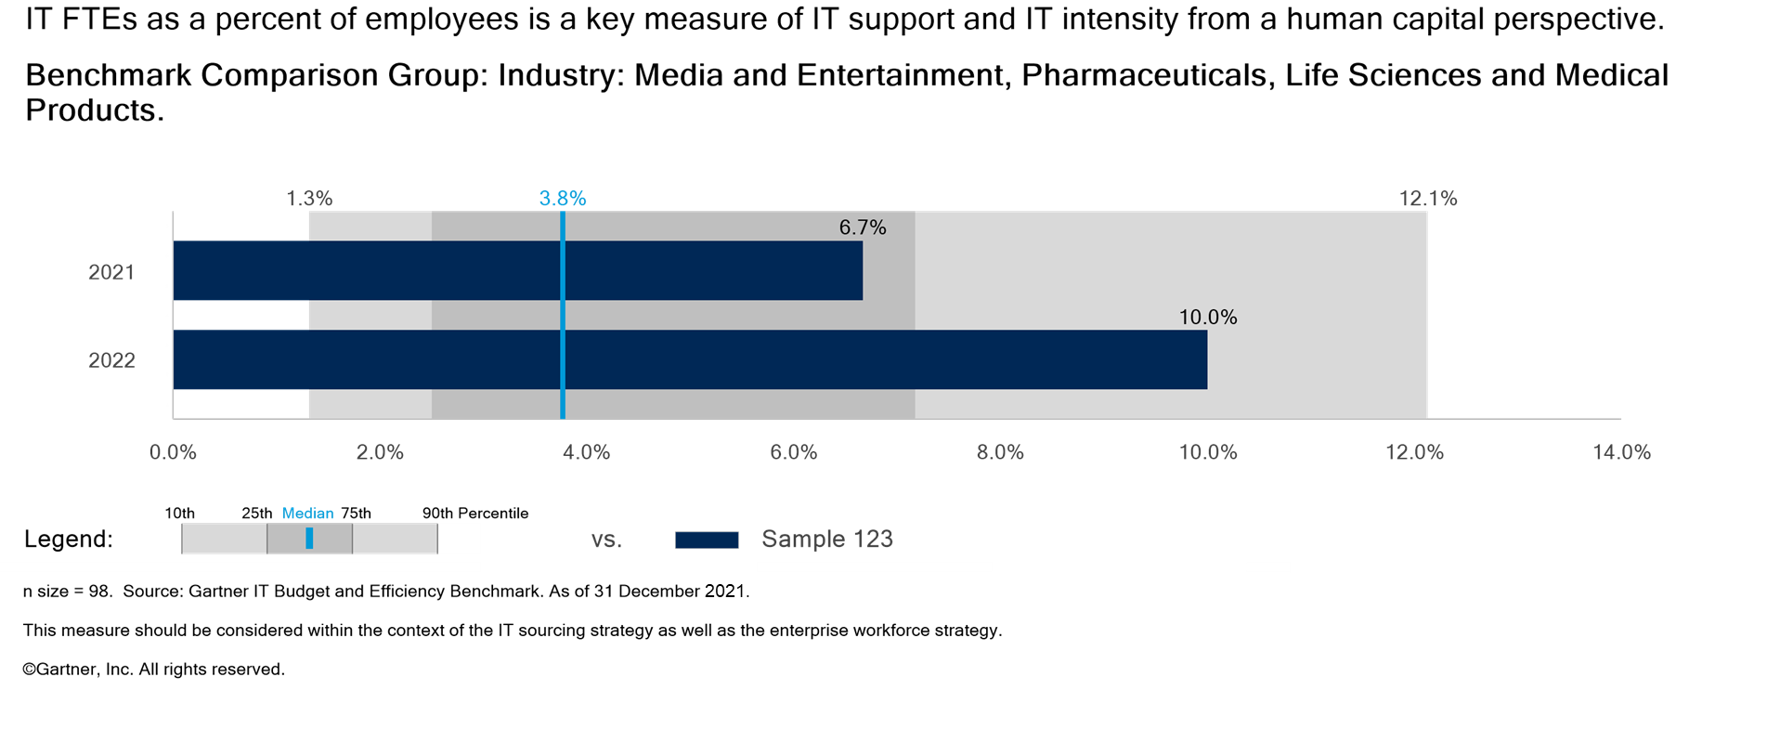
IT Full-time Equivalents as a % of Employees

Slide 30
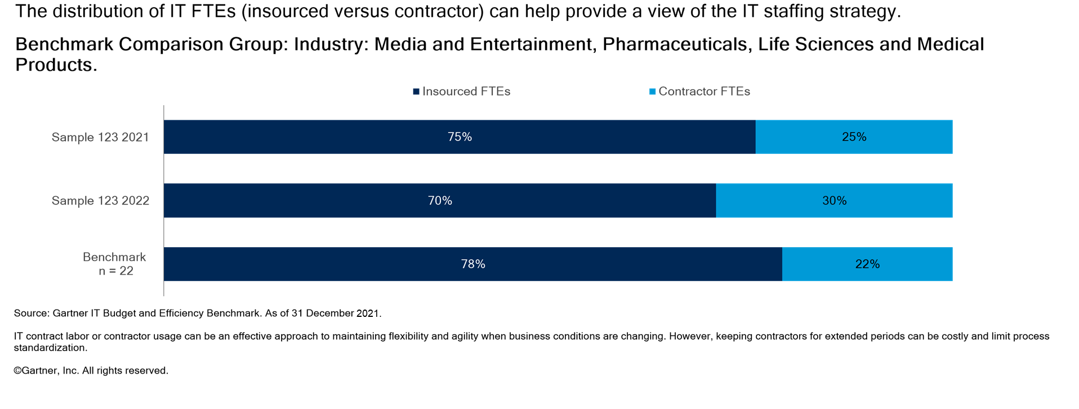
Employee vs. Contractor IT Staffing

Slide 31


Slide 32
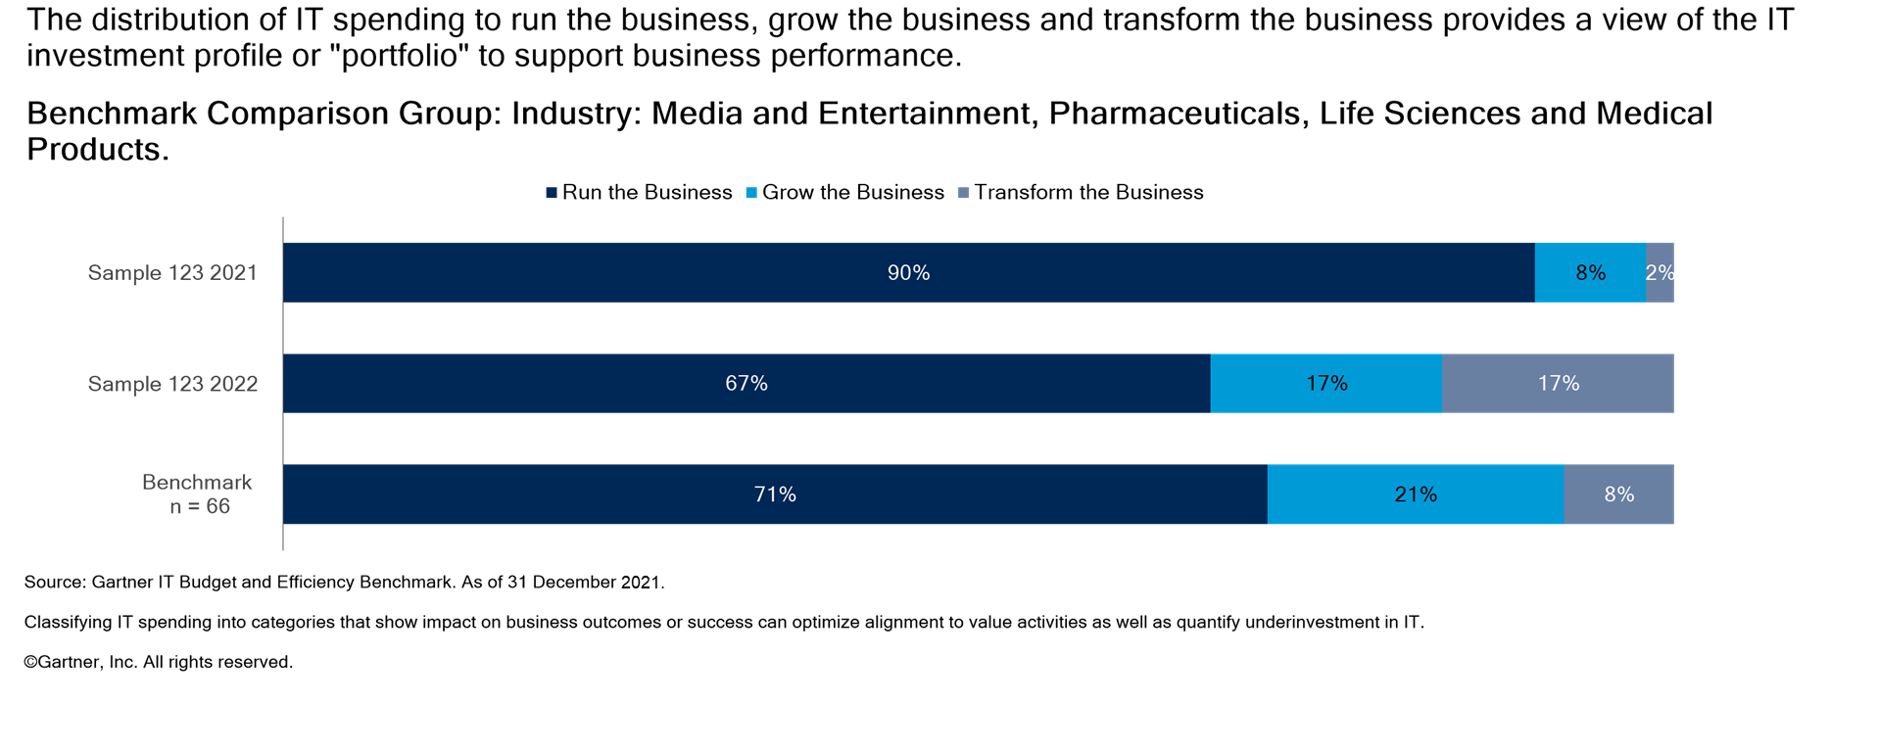
Strategic IT Spending to Change the Business

Slide 33


Slide 34
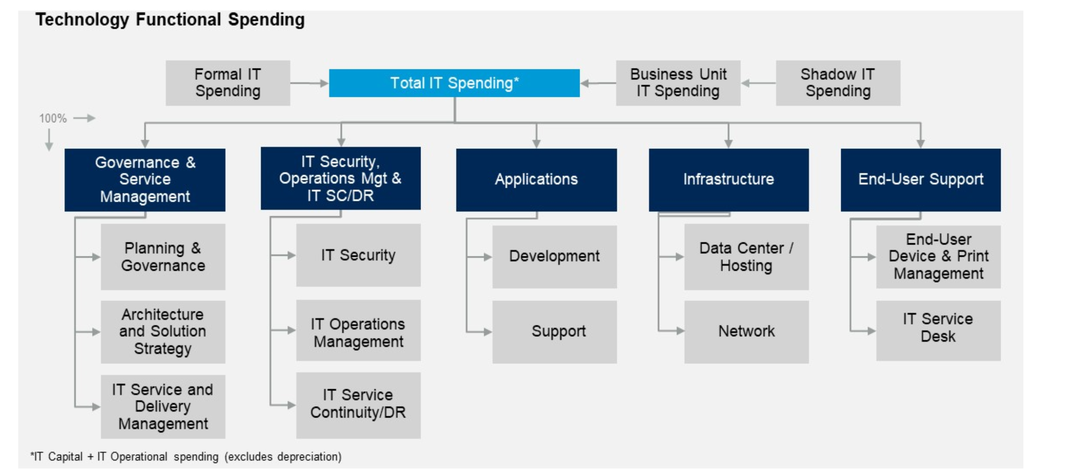
IT Supply-side Technology Cost Management Framework
Governance & Business Management

Slide 35
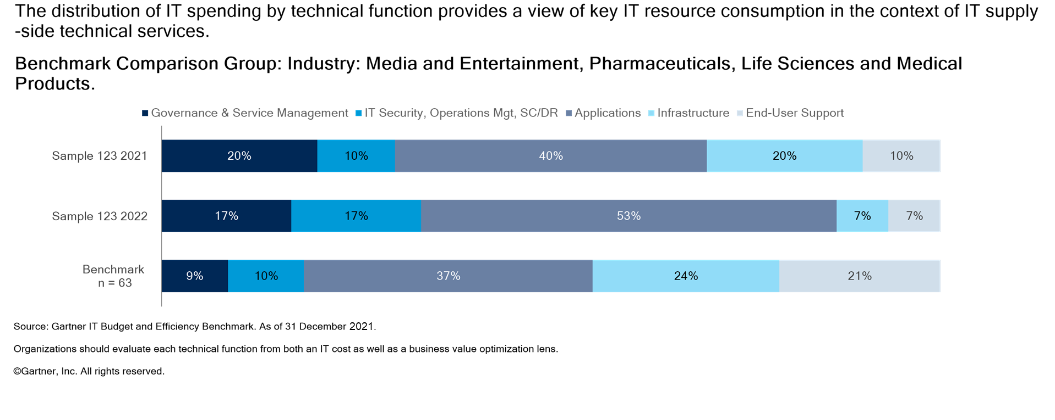
IT Spending Distribution by Technical Function

Slide 36


Slide 37
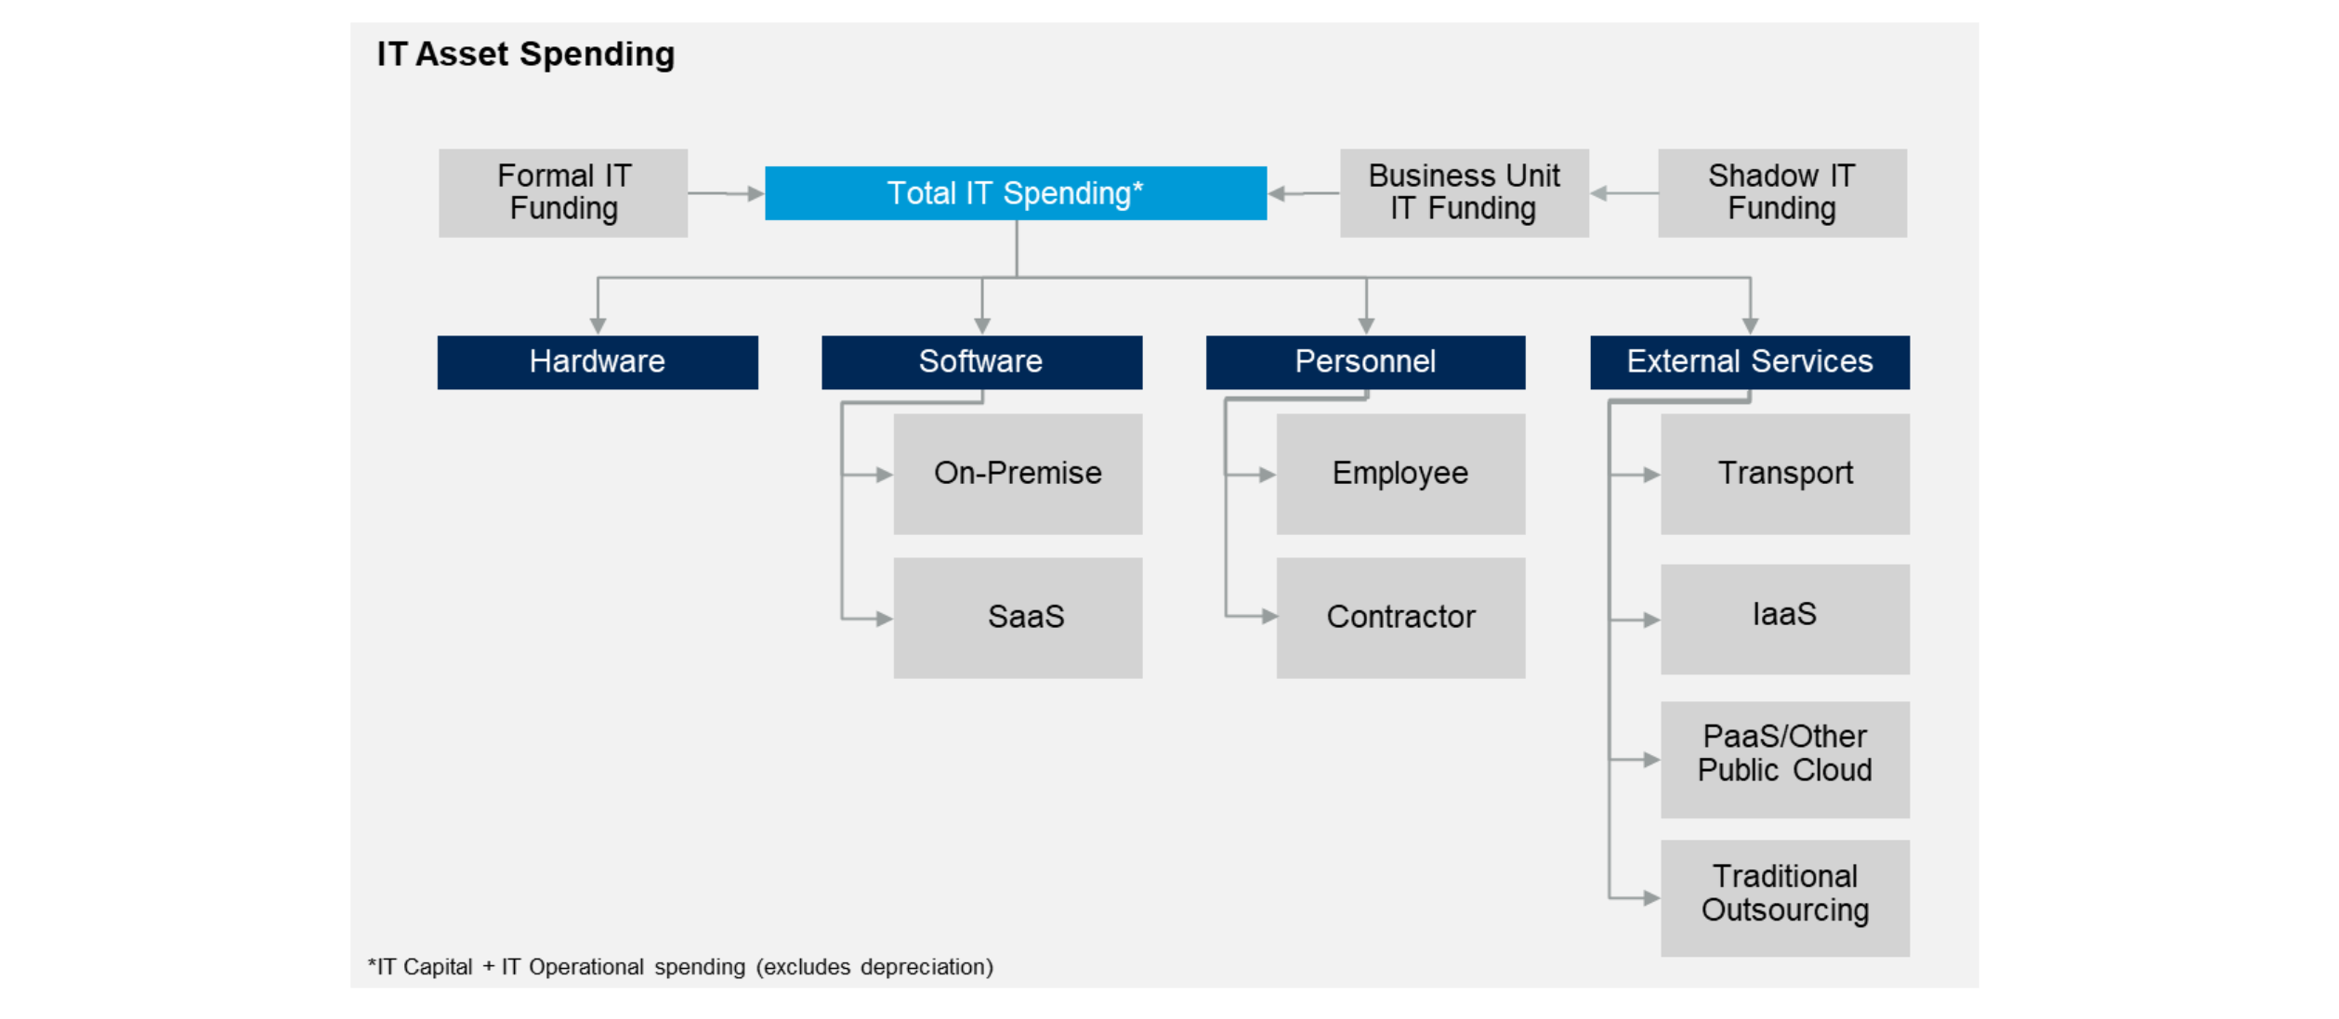
IT Supply-side Asset Cost Management Framework

Slide 38
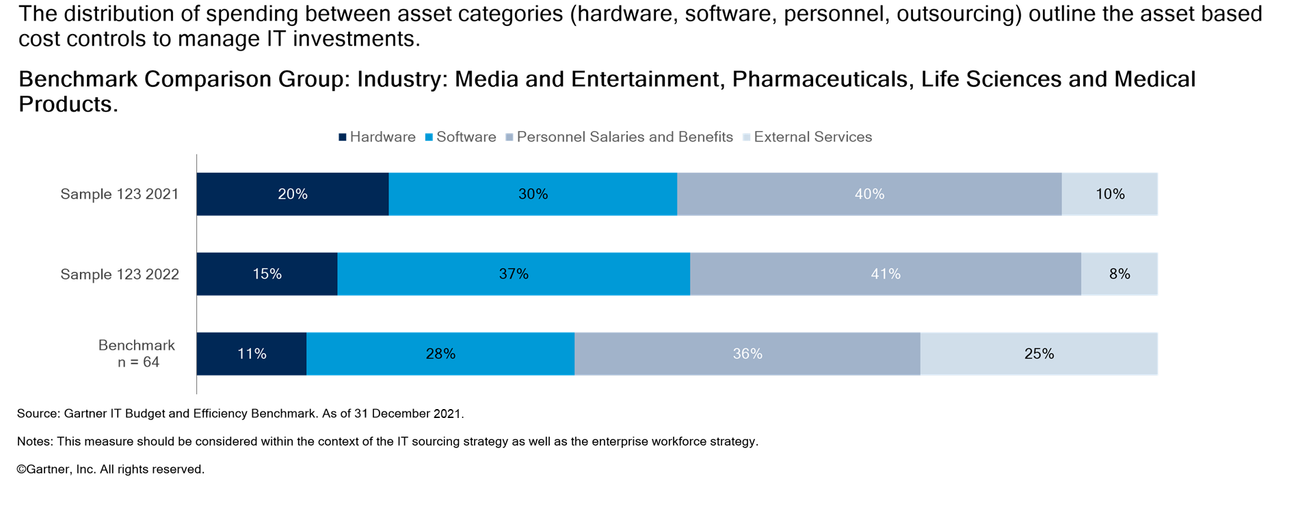
IT Spending Distribution by Asset Class

Slide 39


Slide 40
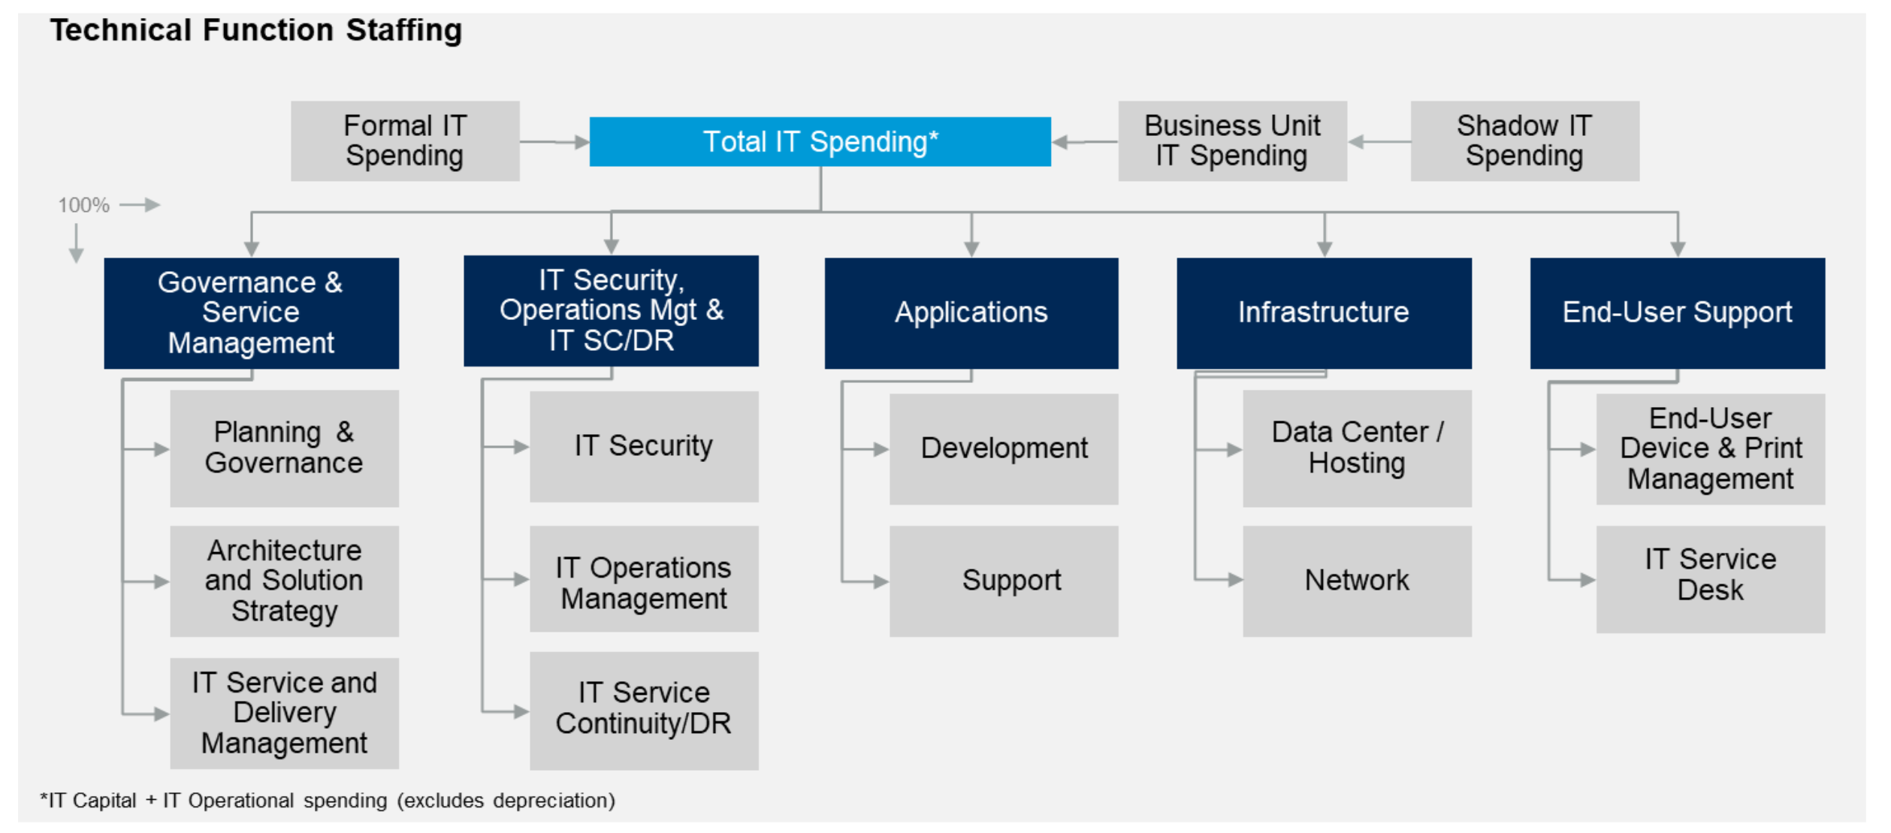
IT Supply-side Technology Cost Management Framework

